Slide 1

PBL presentation for Skills and Competency Evaluation(SCE) Microcontroller And Applications (ETUA22202)(SY ETC SEM-II AY 22-23 )
Alcohol Detector Using 8051
Div.:- A
By: Group No. – A11
Roll No. | G.R. No. | Name of Student | Contact number
211004 | 22110792 | Viraj Badale | 7744048693
211010 | 22110571 | Vishwajeet Dahifale | 7083892213
211014 | 22110110 | Shivam Gaikwad | 9970757606
211021 | 22110721 | Abhijeet Kadam | 8080053515
Name of instructor:
Dr. Pravin G. Gawande
Department of Electronics and Telecommunication Engineering
BRACT’S, Vishwakarma Institute of Information Technology, Pune-48
(An Autonomous Institute affiliated to Savitribai Phule Pune University)
(NBA and NAAC accredited, ISO 9001:2015 certified)

Slide 2
OUTLINE
AIM
OBJECTIVES
HARDWARE MATERIALS ARE REQUIRED AND SPECIFICATIONS
DESIGN (BLOCK DIAGRAM)
INTERFACING DIAGRAM ON PROTEUS
WORKING DESCRIPTION
ALGORITHM/FLOWCHART
PROGRAM IMPLEMENTATION
HARDWARE IMPLEMENTATION
RESULTS AND CONCLUSION
REFERENCES
TITLE OF PAPER IMPLEMENTED USING PBL
Department of Electronics and Telecommunication Engineering, VIIT, Pune-48

Slide 3
AIM
Alcohol consumption impairs the judgement of a person. A person loses the ability to think properly when he has consumed alcohol. This leads to several problems like:
Drinking and driving increasing risks of accidents.
Unintended harmful activities turning into violence.
The project initiative is to create a alcohol detection device using Genuino 101, which will assist officials to find people who have consumed alcohol and ensure they don’t end up doing any dangerous behaviors.
Department of Electronics and Telecommunication Engineering, VIIT, Pune-48

Slide 4
OBJECTIVES
1. The purpose of this project is to develop vehicle accident prevention by method of alcohol detector in an effort to reduce traffic accident cases based on driving under the influence alcohol.
2. This project is developed by integrated the alcohol sensor with the microcontroller.
3. The alcohol sensor used in this project is MQ-3 which detect the present of alcohol content in human breadth.
Department of Electronics and Telecommunication Engineering, VIIT, Pune-48

Slide 5
HARDWARE MATERIAL REQUIRED AND SPECIFICATIONS
8051 Microcontroller
8051 microcontroller is designed by Intel in 1981. It is an 8-bit microcontroller. It is built with 40 pins DIP (dual inline package), 4kb of ROM storage and 128 bytes of RAM storage.
MQ-3 Gas Sensor
The MQ3 sensor is one of the most widely used in the MQ sensor series. It is a MOS (Metal Oxide Semiconductor) sensor. Metal oxide sensors are also known as Chemiresistors because sensing is based on the change in resistance of the sensing material when exposed to alcohol.
LCD
LCD (Liquid Crystal Display) is a type of flat panel display which uses liquid crystals in its primary form of operation. LEDs have a large and varying set of use cases for consumers and businesses, as they can be commonly found in smartphones, televisions, computer monitors and instrument panels.
Department of Electronics and Telecommunication Engineering, VIIT, Pune-48

Slide 6
DESIGN (BLOCK DIAGRAM)
Microcontroller
AT89C52
Alcohol Detector Sensor
(MQ-3)
LCD
LED
Department of Electronics and Telecommunication Engineering, VIIT, Pune-48

Slide 7
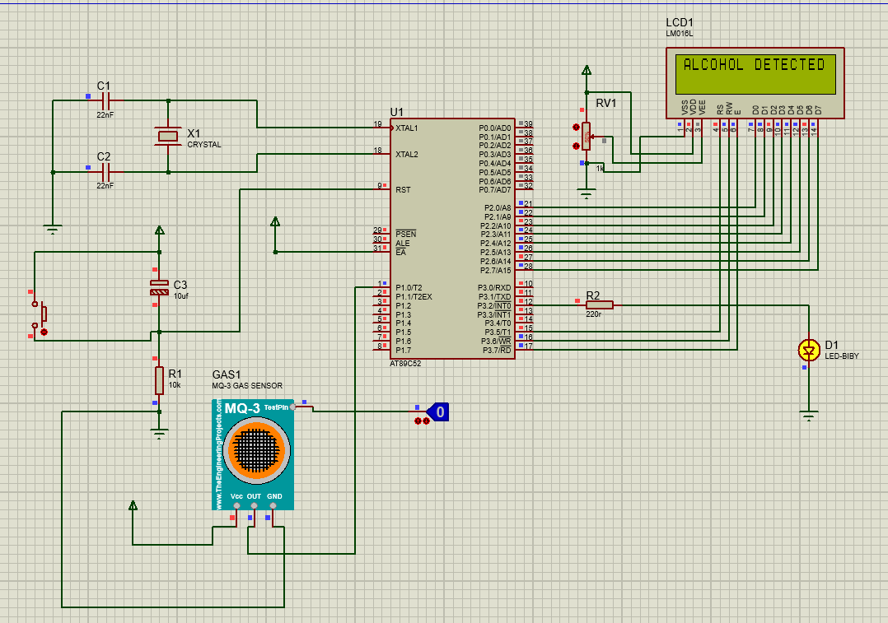
INTERFACING DIAGRAM ON PROTEUS
Department of Electronics and Telecommunication Engineering, VIIT, Pune-48

Slide 8
WORKING DESCRIPTION
The alcohol sensor is technically referred to as a MQ3 sensor which detects ethanol in the air. When a drunk person breathes near the alcohol sensor it detects the ethanol in his breathe. Hence you can get to know about the concentration and thus detect alcohol.
And it provides output through digital pin to the 8051 Microcontroller. And 8051 performs actions according to output of the MQ3 sensor.
Department of Electronics and Telecommunication Engineering, VIIT, Pune-48

Slide 9
ALGORITHM/FLOWCHART
Start
Initialize Port 1 to take Input and
Port 3 for output
Check output given by Alcohol sensor to 8051
0
1
Give output to LCD to print “Alcohol Detected” and turn on LED
Give output to LCD to print “Alcohol Not Detected” and turn off LED
Call Delay
Call Delay
Department of Electronics and Telecommunication Engineering, VIIT, Pune-48

Slide 10
ALGORITHM/FLOWCHART
Start
Intialize Port 1 for input and Port 3 for output
Check output given by Alcohol sensor to 8051
If given output of Alcohol sensor is 0, give output to LCD to print ‘Alcohol Detected’ message and turn on the LED
If given output of Alcohol sensor is 1, give output to LCD to print ‘Alcohol Not Detected’ message and turn off the LED
4. Call Delay
5. Jump to Step 3
6. End
Department of Electronics and Telecommunication Engineering, VIIT, Pune-48

Slide 11
PROGRAM IMPLEMENTATION
Department of Electronics and Telecommunication Engineering, VIIT, Pune-48

Slide 12
HARDWARE IMPLEMETATION
…..
Department of Electronics and Telecommunication Engineering, VIIT, Pune-48

Slide 13
RESULTS AND CONCLUSION
The project alcohol detector using 8051 microcontroller is a device designed to detect the presence of alcohol in a person's breath. The device is controlled by an 8051 microcontroller, which is responsible for processing the data from the alcohol sensor and displaying the results on an LCD screen.
Overall, the project appears to be a successful implementation of a simple alcohol detector using readily available components. The use of an 8051 microcontroller provides an efficient and reliable method for controlling the device and displaying the results. However, the effectiveness of the alcohol sensor and the accuracy of the readings may vary depending on the specific sensor used and the conditions in which the device is used.In conclusion, the alcohol detector using 8051 microcontroller is a useful tool for detecting the presence of alcohol in a person's breath, but it should not be relied upon as the sole method of determining sobriety. It is important to use the device in conjunction with other measures, such as field sobriety tests or blood alcohol content (BAC) tests, to ensure accurate and reliable results.
Department of Electronics and Telecommunication Engineering, VIIT, Pune-48

Slide 14
REFERENCES
"Alcohol Detection System using 8051 Microcontroller" by R. R. Reddy, K. T. Gopi, and K. V. H. Sai. (https://www.researchgate.net/publication/344291144_Alcohol_Detection_System_using_8051_Microcontroller)
"Design and Implementation of an Alcohol Detection System using MQ-3 Sensor and 8051 Microcontroller" by R. S. Amruta, S. S. Bhattacharya, and S. S. Das. (https://ieeexplore.ieee.org/document/8975771)
"Design and Development of an Alcohol Detection System using 8051 Microcontroller" by M. K. Singh and A. K. Shrivastava. (https://www.sciencedirect.com/science/article/pii/S1877050915012333)“
Alcohol Detection System using 8051 Microcontroller and GSM Modem" by R. B. H. Bhaskar, D. L. Gohil, and P. R. Pujara. (https://ieeexplore.ieee.org/document/7463227)
"Development of an Alcohol Detection System using 8051 Microcontroller and LCD Display" by V. R. Mane, S. P. Pawar, and S. A. Patil. (https://ieeexplore.ieee.org/document/8279161)“
A Low-Cost and Portable Alcohol Detection System using 8051 Microcontroller" by V. M. Ramana, K. R. K. Rao, and M. V. P. Raju. (https://www.sciencedirect.com/science/article/pii/S1877050915014537)
…..
Department of Electronics and Telecommunication Engineering, VIIT, Pune-48

Slide 15
TITLE OF PAPER IMPLEMENTED USING PBL
Design and Implementation of an Alcohol Detector System using 8051 Microcontroller
Department of Electronics and Telecommunication Engineering, VIIT, Pune-48

